Slide 1
DHCP Attacks

Slide 2
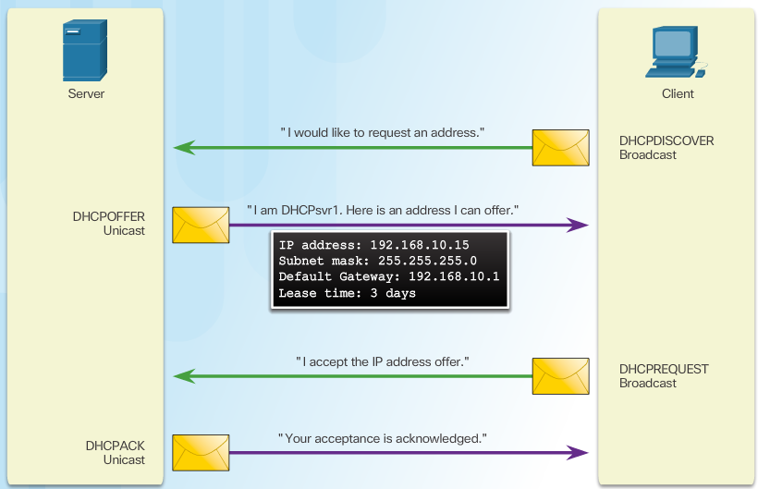
DHCP Spoofing Attack
Notes:
6.2.5.1 DHCP Spoofing Attack

Slide 3
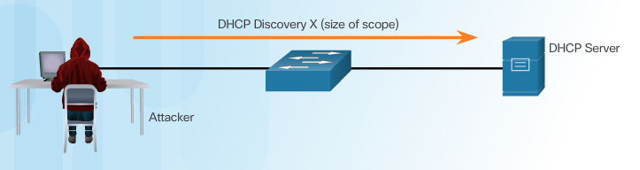
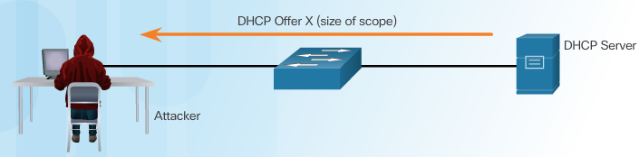
DHCP Starvation Attack
Attacker Initiates a Starvation Attack
DHCP Server Offers Parameters
Notes:
6.2.5.2 DHCP Starvation Attack

Slide 4
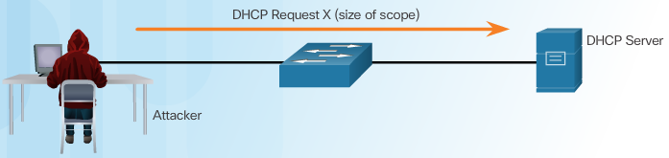
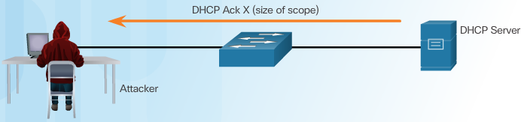
DHCP Starvation Attack
Client Requests all Offers
DHCP Server Acknowledges All Requests
Notes:
6.2.5.2 DHCP Starvation Attack (Cont.)

Slide 5
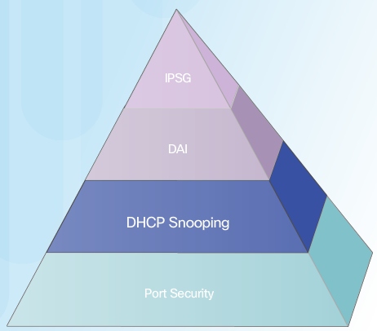
Mitigating VLAN Attacks
The switch will deny packets containing specific information:
Unauthorized DHCP server messages from an untrusted port
Unauthorized DHCP client messages not adhering to the snooping binding table or rate limits
DHCP relay-agent packets that include option-82 information on an untrusted port
Notes:
1.2.3.3 Trojan Horses
1.2.3.4 Trojan Horse Classification

Slide 6
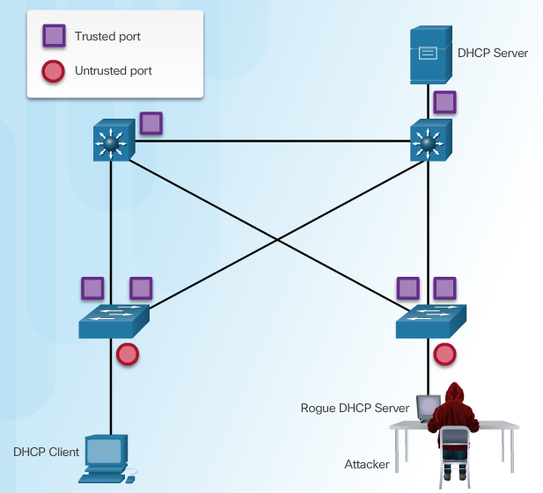
Configuring DHCP Snooping
Notes:
6.2.5.4 Configuring DHCP Snooping
6.2.5.5 Configuring DHCP Snooping Example

Slide 7

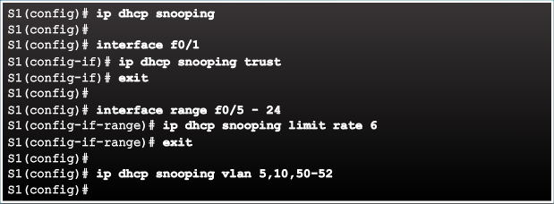
Configuring DHCP Snooping Example
DHCP Snooping Reference Topology
Configuring a Maximum Number of MAC Addresses
Notes:
6.2.5.5 Configuring DHCP Snooping Example

Slide 8
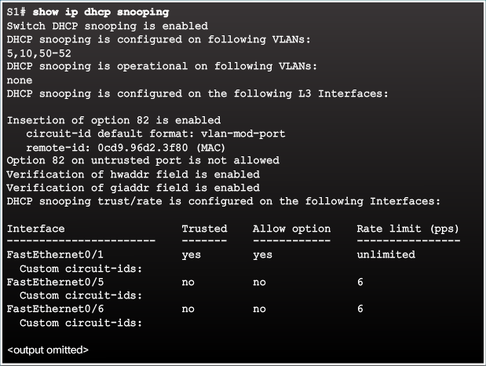

Configuring DHCP Snooping Example
Verifying DHCP Snooping
Configuring a Maximum Number of MAC Addresses
Notes:
6.2.5.5 Configuring DHCP Snooping Example (Cont.)

Slide 9

Mitigating ARP Spoofing and ARP Poisoning Attack

Slide 10
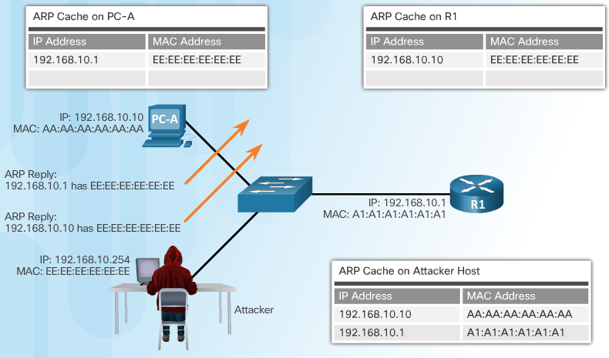
ARP Spoofing and ARP Poisoning Attack
Notes:
6.2.6.1 ARP Spoofing and ARP Poisoning Attack

Slide 11
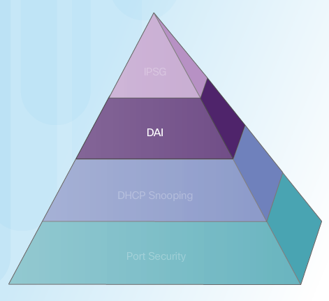
Mitigating ARP Attacks
Dynamic ARP Inspection:
DAI associates each interface with a trusted state or an untrusted state.
Trusted interfaces bypass all DAI.
Untrusted interfaces undergo DAI validation.
Notes:
6.2.6.2 Mitigating ARP Attacks

Slide 12
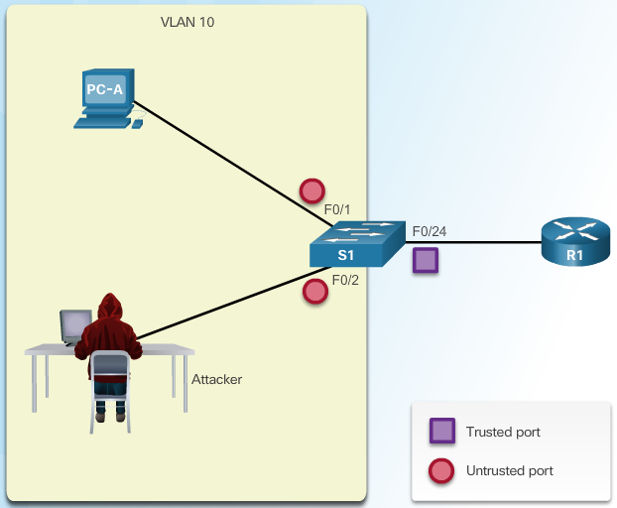
Configuring Dynamic ARP Inspection
Notes:
6.2.6.4 Configuring Dynamic ARP Inspection
6.2.6.5 Configuring Dynamic ARP Inspection Example

Slide 13
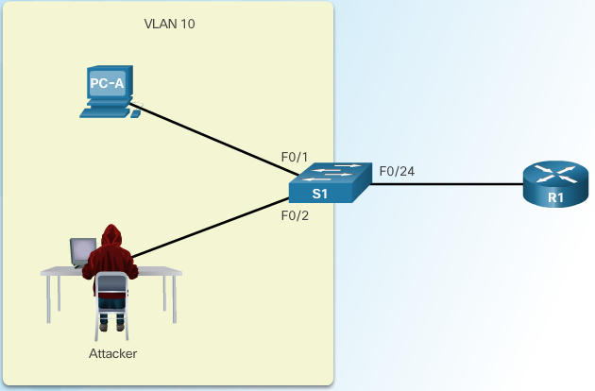
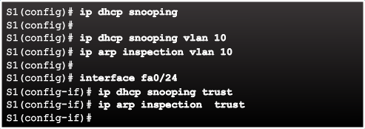
Configuring DHCP Snooping Example
ARP Reference Topology
Configuring Dynamic ARP Inspection
Notes:
6.2.6.4 Configuring Dynamic ARP Inspection Example

Slide 14
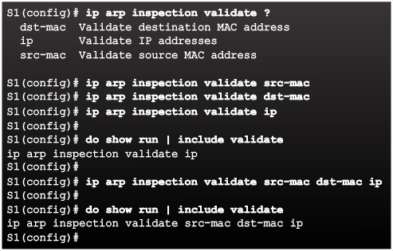
Configuring DHCP Snooping Example
Checking Source, Destination, and IP
Notes:
6.2.6.4 Configuring Dynamic ARP Inspection Example (Cont.)

Slide 15
Mitigating Address Spoofing Attacks

Slide 16
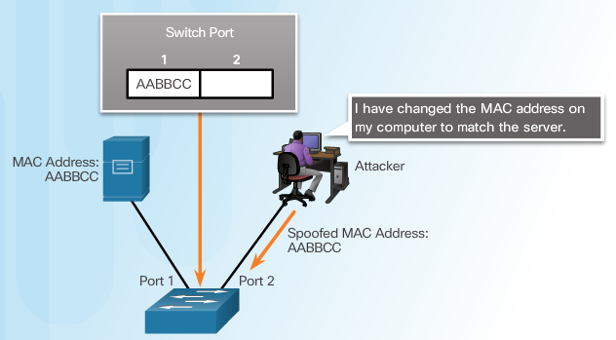
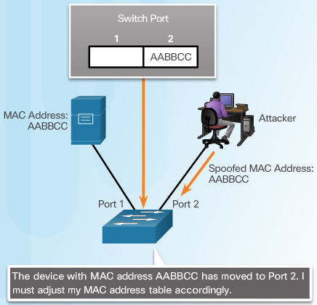
Address Spoofing Attack
Notes:
6.2.7.1 Address Spoofing Attack

Slide 17
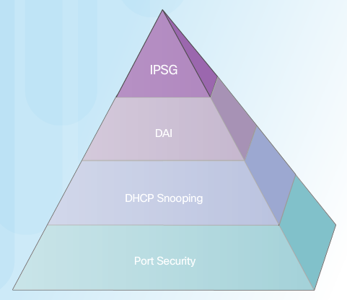
Mitigating Address Spoofing Attacks
For each untrusted port, there are two possible levels of IP traffic security filtering:
Source IP address filter
Source IP and MAC address filter
Notes:
6.2.7.2 Mitigating Address Spoofing Attacks

Slide 18
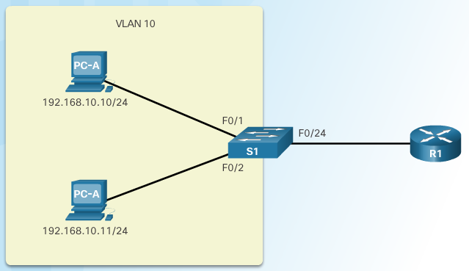

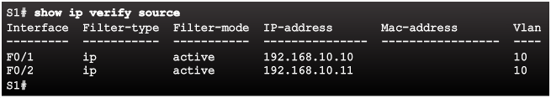
Configuring IP Source Guard
IP Source Guard Reference Topology
Configuring IP Source Guard
Checking IP Source Guard
Notes:
6.2.7.3 Configuring IP Source Guard

Slide 19
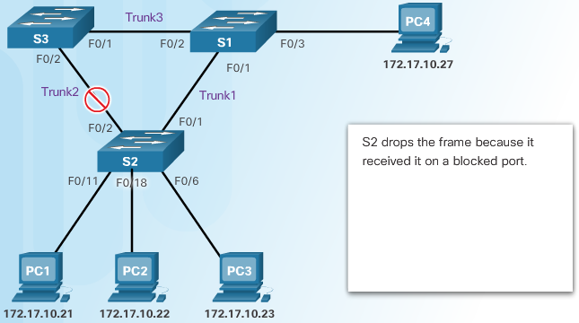
Introduction to the Spanning Tree Protocol
Notes:
6.2.8.1 Introduction to the Spanning Tree Protocol

Slide 20
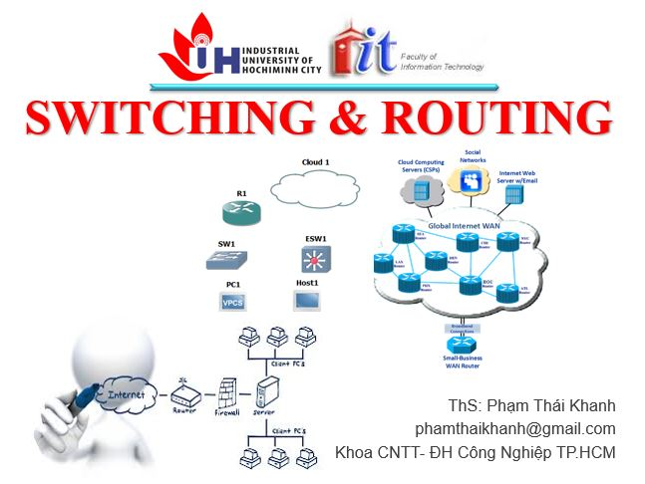

phamthaikhanh@gmail.com
This Photo by Unknown Author is licensed under CC BY-NC

